Slide 1


FLIGHTS
BIG DATA
AURORA TOMA

Slide 2
OBJECTIVE
Exploit the CRISP-DM (CRoss Industry Standard Process for Data Mining)* process to apply a regression task to predict the departure delay of flights across various airlines, comparing boosting techniques with bagging ones.

Slide 3


1.1
1. BUSINESS UNDERSTANDING
1.1 DETERMINE BUSINESS OBJECTIVE
1.2
It involves developing a thorough understanding and careful definition of the business needs.
OUTPUT:
Background: we can assume that I own a company that is tasked with monitoring the performance of various airlines.
Business Objectives: predict departure delays by utilizing the characteristics present in the data.
Business Success Criteria: operational efficiency (improvement in resource utilization, cost reduction and better service delivery), and customer satisfaction.
It focuses on gaining a deep
understanding of the business context and the specific goals of the project.
1.3

Slide 4
1.1 DETERMINE BUSINESS OBJECTIVE
It involves the definition of the business needs.
OUTPUT:
Background: we can assume that I own a company that is tasked with monitoring the performance of various airlines.
Business Objectives: predict departure delays by using the characteristics present in the data.
Business Success Criteria: operational efficiency (improvement in resource utilization, cost reduction and better service delivery), and customer satisfaction.
1.2 ASSESS SITUATION
It involves understanding the broader context in which the project will take place.
OUTPUT:
Inventory of Resources: computer scientist as personnel; performance and various pieces of information related to airlines as data;
Inventory of Assumptions: data availability related to the airlines, with medium-high quality; formats standardization and missing values handling needed.

Slide 5


1.2 ASSESS SITUATION
1.3 DETERMINING DATA MINING
GOALS
It involves to understand the context in which the project will take place.
OUTPUT:
Inventory of Resources: computer scientist as personnel; information related to airlines as data;
Inventory of Assumptions: data availability related to the airlines, with medium-high quality; formats standardization and missing values handling needed.
It involves to translate the primary business objectives into data mining goals using technical terminology.
OUTPUT:
Data Mining Goals: apply a regression task to predict the departure delay of flights across various airlines, comparing boosting techniques with bagging techniques.
Data Mining Success Criteria: measured by performance metrics such as the Mean Absolute Error (MAE), Mean Squared Error (MSE) and Root Mean Squared Error (RMSE).

Slide 6

1.3 DETERMINING DATA MINING
GOALS
It involves to translate the primary business objectives into data mining goals using technical terminology.
OUTPUT:
Data Mining Goals: apply a regression task to predict the departure delay of flights across various airlines, comparing boosting techniques with bagging techniques.
Data Mining Success Criteria: measured by performance metrics such as the Mean Absolute Error (MAE), Mean Squared Error (MSE) and Root Mean Squared Error (RMSE).

Slide 7

2.1
2.1 DETERMINE BUSINESS OBJECTIVE
2. DATA UNDERSTANDING
2.2
It involves to access relevant data from the inventory of resources.
OUTPUT:
Initial Data Collection Report:
The dataset is stored locally on the system and a backup copy of the dataset is saved on OneDrive space;
The dataset was acquired from Kaggle, and the acquisition process was seamless, with no issues encountered.
It focuses on acquiring and exploring the data
to ensure it is suitable for the subsequent analysis.
2.3
2.4

Slide 8
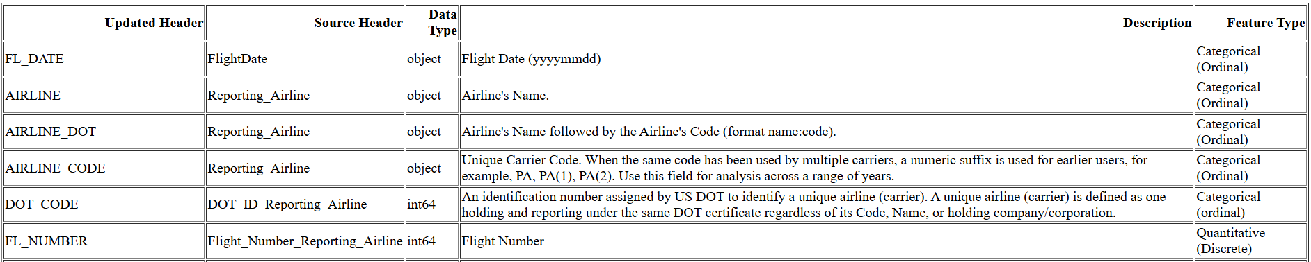
2.1 INITIAL DATA COLLECTION
2.2 DATA DESCRIPTION
It involves to access relevant data from the inventory of resources.
OUTPUT:
Initial Data Collection Report:
The dataset is stored locally on the system and a backup copy of the dataset is saved on OneDrive space;
The dataset was acquired from Kaggle, and the acquisition process was seamless, with no issues encountered.
It involves examining the properties of the dataset, exploring the data in detail, uncovering its structure, formats and potential values.
OUTPUT:
Data Description Report: includes information related to the nature of features, describing them as categorical (nominal or ordinal), or quantitative (discrete or continuous).

Slide 9



2.2 DATA DESCRIPTION
2.3 DATA QUALITY VERIFICATION
It involves to analyze the properties of the dataset, exploring the data in detail, uncovering its structure or formats.
OUTPUT:
Data Description Report: includes information related to the nature of features, describing them as categorical (nominal or ordinal), or quantitative (discrete or continuous).
It involves to evaluate the quality of the dataset to ensure its suitability for analysis.
OUTPUT:
Data Quality Report including
Summary of Finding such as accuracy, completeness, consistency, and up-to-dateness;
Identification of Data Quality Problems such as missing values, inaccuracies, or inconsistencies;
Discussion of Potential Solutions to address these issues.

Slide 10

2.3 DATA QUALITY VERIFICATION
It involves to evaluate the quality of the dataset to ensure its suitability for analysis.
OUTPUT:
Data Quality Report including
Summary of Finding such as accuracy, completeness, consistency, and up-to-dateness;
Identification of Data Quality Problems such as missing values, inaccuracies, or inconsistencies;
Discussion of Potential Solutions to address these issues.

Slide 11
2.3 DATA QUALITY VERIFICATION
Summary of Findings
Accuracy and up-to-dateness of the data considered implicit;
Check for the presence of null values applied;
Consistency checks performed to ensure that the values in specific columns adhered to the formats specified in the data description report.

Slide 12
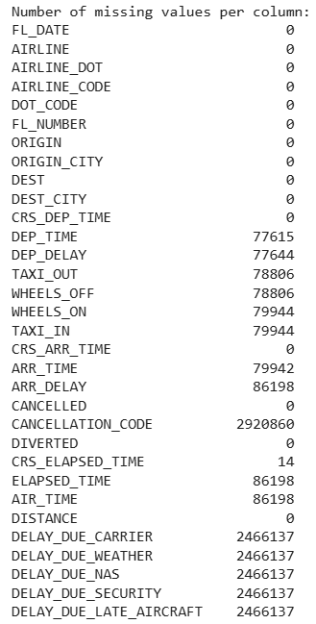
2.3 DATA QUALITY VERIFICATION
Identification of Data Quality Problems
Completeness not guaranteed;
Consistency:
There are no values different from 0 or 1 in CANCELLED and DIVERTED columns;
All values in FL_DATE column are coherent with ‘yyyy-mm-dd’ format;
All values in CRS_DEP_TIME column are coherent with ‘hhmm’ format;
There are non valid values in CRS_ARR_TIME column (fourteen values equal to ‘2400’, that should correspond to ‘0000’);
DEP_TIME and ARR_TIME columns contain many non coherent values (NaN values - ‘2400.0’ values).

Slide 13
2.3 DATA QUALITY VERIFICATION
Potential Solutions
2.4 DATA EXPLORATION
Issues related to missing values:
Delete useless columns containing most null values (DELAY_DUE_<something> and CANCELLATION_CODE);
Delete useless columns with respect to the main goal defined for this project (TAXI_OUT and TAXI_IN);
Delete remaining rows containing NaN values (their amount represents only a small percentage of the entire dataset).
Issues related to consistency lack:
Conversion of ‘2400’ values into ‘0000’ for both CRS_ARR_TIME and ARR_TIME columns.
It involves the understanding the structure, quality, and patterns
within a dataset.
OUTPUT
Data Exploration Report: contains insights related to analyzed
features, separating them into categorical and quantitative ones.

Slide 14



2.4 DATA EXPLORATION
It involves to understand the structure, quality, and patterns
within a dataset.
OUTPUT
Data Exploration Report: contains insights related to analyzed
features, separating them into categorical and quantitative ones.

Slide 15
2.4 DATA EXPLORATION
Categorical Variables
Frequency distribution observations:
Consistency between AIRLINE and AIRLINE_DOT;
Mismatch between ORIGIN/DEST and ORIGIN_CITY/DEST_CITY (380 unique values in both ORIGIN and DEST columns but only 373 unique values in ORIGIN_CITY and DEST_CITY);
Extremely low-frequency values for several airport codes, such as ILG (Wilmington, DE), FLO (Florence, SC), and IPT (Williamsport, PA), with fewer than 20 occurrences as either origin or destination;
Uneven Distribution. Major hubs like Atlanta (ATL), Dallas/Fort Worth (DFW), and Chicago (ORD) dominate the data, as expected for large airports.

Slide 16
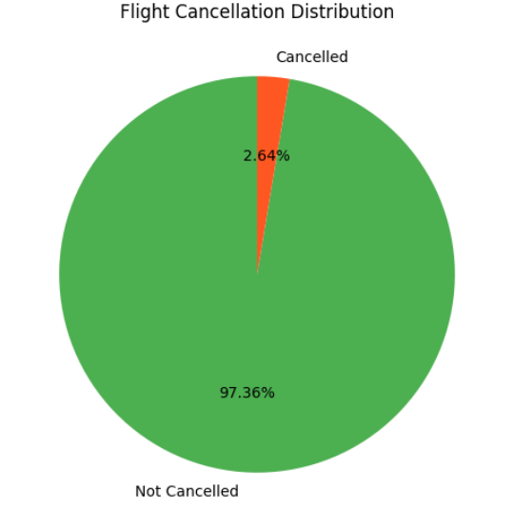
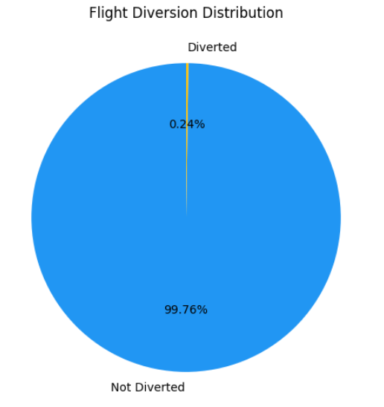
2.4 DATA EXPLORATION
Categorical Variables – Pie Charts

Slide 17
2.4 DATA EXPLORATION
Quantitative Variables
Computation of minimum and maximum values; mean, median, mode, and standard deviation.
General observations:
Scheduled vs Actual Times: Actual flight durations (ELAPSED_TIME) tend to be slightly shorter than scheduled durations (CRS_ELAPSED_TIME), reflecting adjustments in flight operations.
Delays: Both departure and arrival times show significant variability, with most flights on time or early, but also with extreme delays.
Distance: The dataset predominantly includes short and medium haul flights, with fewer long haul flights.

Slide 18
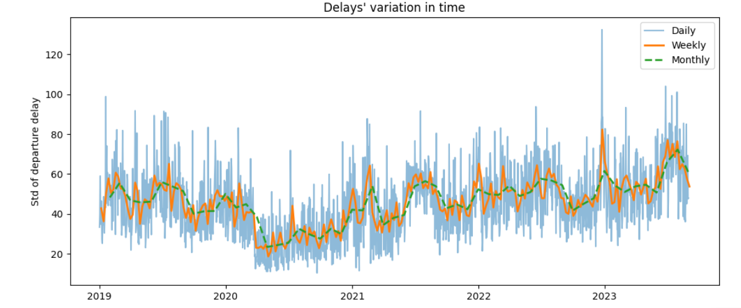
2.4 DATA EXPLORATION
Quantitative Variables
Pattern searching applied considering how quickly flight delays vary over the period
from 1/01/2019, to 31/08/2023, based on the available data.

Slide 19
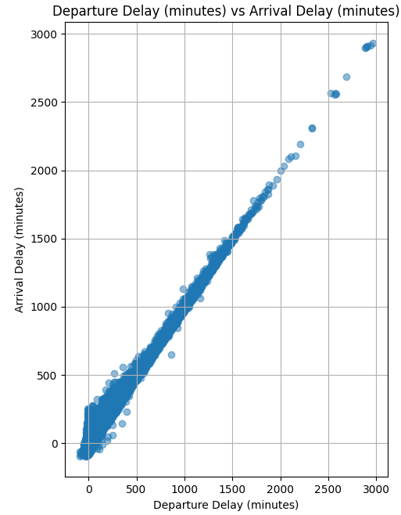
2.4 DATA EXPLORATION
Quantitative Variables - Scatterplot
The most significant relationship is observed between DEP_DELAY and ARR_DELAY, where a clear linear trend is evident (it’s common knowledge).
Instead, variables such as AIR_TIME, DISTANCE, and CRS_ELAPSED_TIME exhibit weak or no correlation with departure delays, indicating that they may not be useful as primary predictors.

Slide 20
3.1
3. DATA PREPARATION
3.2
It focuses on transforming raw data into a suitable format for
analysis and knowledge extraction.
3.3

Slide 21
3.1 DATA CLEANING
It addresses issues such as missing values, errors, duplicates, and noise that could negatively impact the analysis.
OUTPUT:
Data Cleaning Report:
Deletion of columns containing the majority of null values, along with useless columns with respect to the main goal defined for this project;
Dropping rows containing NaN values;
Conversion of ‘2400’ values into ‘0000’ applied.

Slide 22

3.2 DATA SELECTION
It focuses on identifying the most relevant variables to improve model performance and reduce dimensionality.
OUTPUT:
Inclusion/Exclusion Rationale Report: contains insights related to the features selection technique applied, along with its gained results.

Slide 23
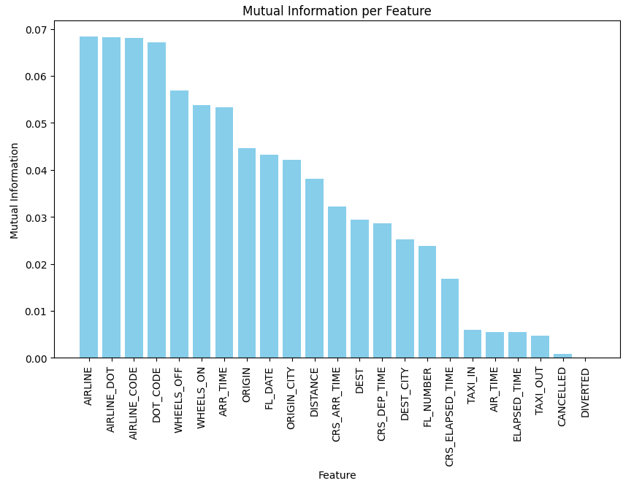
3.2 DATA SELECTION
Filter Model – Information Gain
Features related to airline identification and operational metrics show the higher relevance with respect to the others;
Several features demonstrate minimal mutual information, indicating their limited predictive value

Slide 24
3.3 DATA CONSTRUCTION
It entails creating new variables or features derived from existing ones to better represent the hidden characteristics of the dataset.
Label Encoding method used to convert categorical variables
into numerical variables;
Necessary because the mutual information measure operates on numerical values;
No other transformation considered as the exploited models do not require specific data formats.

Slide 25
4.1
4.1 MODELING TECHNIQUES SELECTION
4. MODELING
4.2
It involves the application of pre-selected techniques and tools to build predictive or
descriptive models that address the business objectives defined earlier.
It involves the definition of models to be applied.
Bagging techniques:
Random Forest Regressor;
Extra Trees Regressor;
Boosting techniques:
Ada Boost Regressor;
Gradient Boosting Regressor;
XGBoost.
4.3
4.4

Slide 26
4.1 MODELING TECHNIQUES SELECTION
4.2 TEST DESIGN GENERATION
It ensures that the performance of machine learning models is rigorously evaluated before their deployment.
OUTPUT:
Structured test design outlining the procedure for training, testing, and evaluating models.
The dataset will be divided as Train-test split (80% training, 20% test) without cross-validation;
Since this is a regression task, the evaluation metrics will be MSE, RMSE, MAE;
Results will be analyzed providing an interpretation.
It involves the definition of models to be applied.
Bagging techniques:
Random Forest Regressor;
Extra Trees Regressor;
Boosting techniques:
Ada Boost Regressor;
Gradient Boosting Regressor;
XGBoost.

Slide 27




4.2 TEST DESIGN GENERATION
4.3 MODEL BUILD
It ensures that the performance of machine learning models is rigorously evaluated before their deployment.
OUTPUT:
Structured test design outlining the procedure for training, testing, and evaluating models.
The dataset will be divided as Train-test split (80% training, 20% test) without cross-validation;
Since this is a regression task, the evaluation metrics will be MSE, RMSE, MAE;
Results will be analyzed providing an interpretation.
It involves training and optimizing the machine learning models previously discussed to generate predictions based on the dataset.

Slide 28
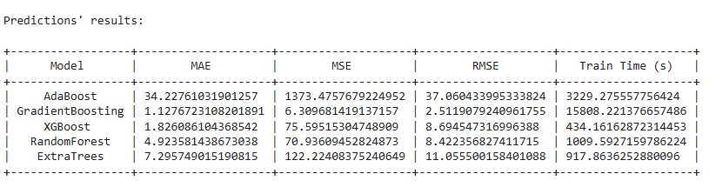
4.3 MODEL BUILD
4.4 MODEL ASSESSMENT
It involves to train the machine learning models previously discussed to generate predictions based on the dataset.
It is aimed at evaluating the trained models to determine their effectiveness in making predictions.
RESULTS

Slide 29
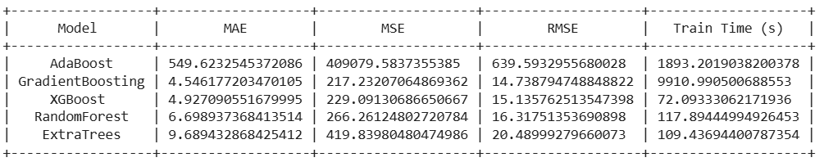
4.4 MODEL ASSESSMENT
It is aimed at evaluating the trained models to determine their effectiveness in making predictions.
RESULTS

Slide 30
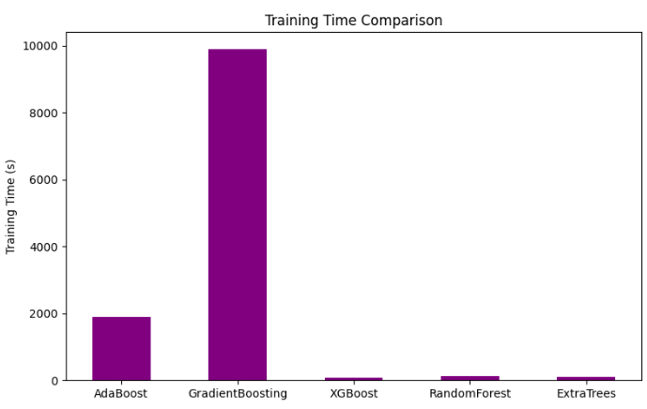
4.4 MODEL ASSESSMENT
Results’ Visualization

Slide 31
CONCLUSIONS
Boosting techniques outperformed Bagging techniques in predicting flight departure delays.
XGBoost appears to be the most promising model, offering an
optimal balance between predictive accuracy and computational efficiency.
Gradient Boosting provides the best accuracy, but it is time consuming.

Slide 32
THANKS
BIG DATA
AURORA TOMA

